Slide 1
State of the Township
March 10, 2016

Slide 2
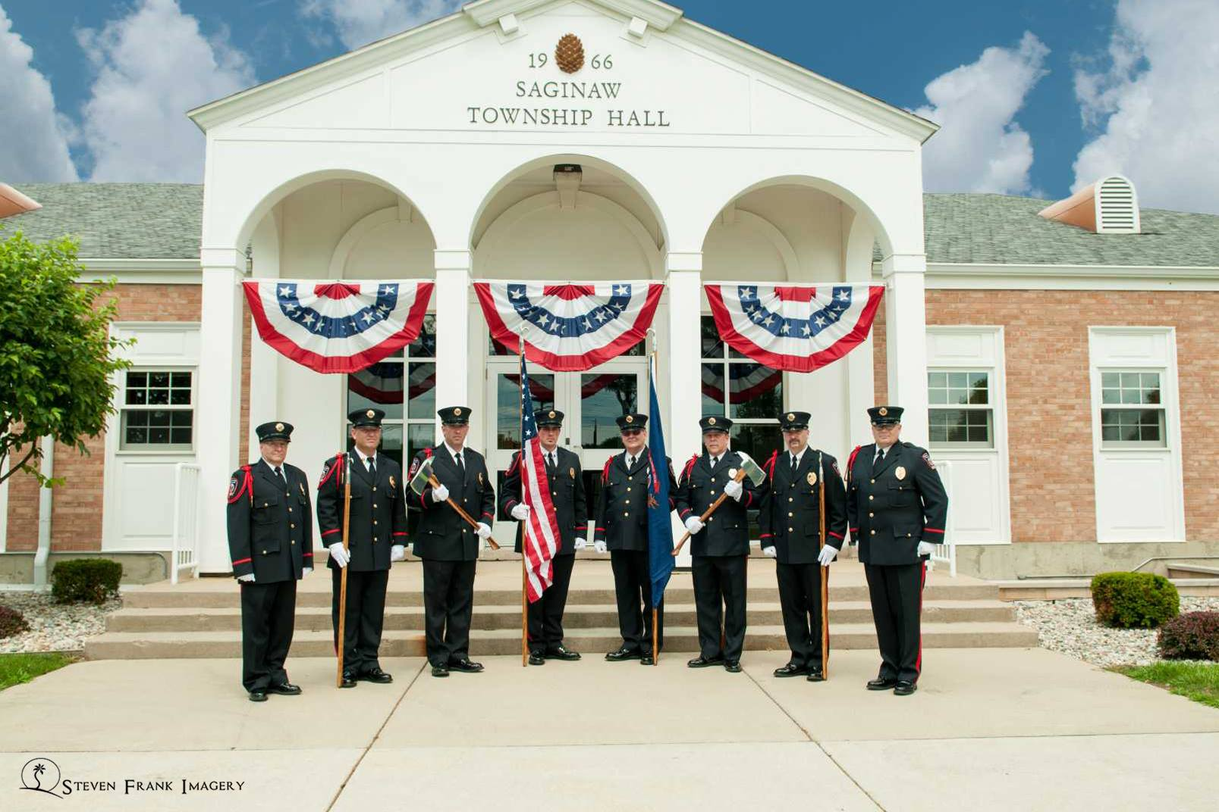

Slide 3
Notes:
https://youtu.be/YxB_m6TwFdc

Slide 4
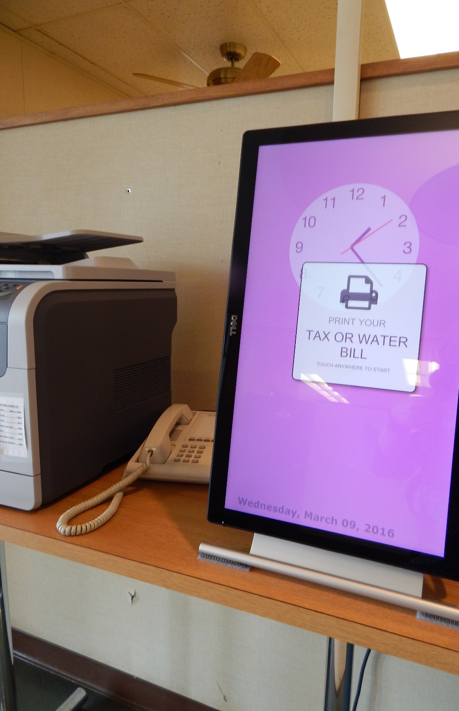
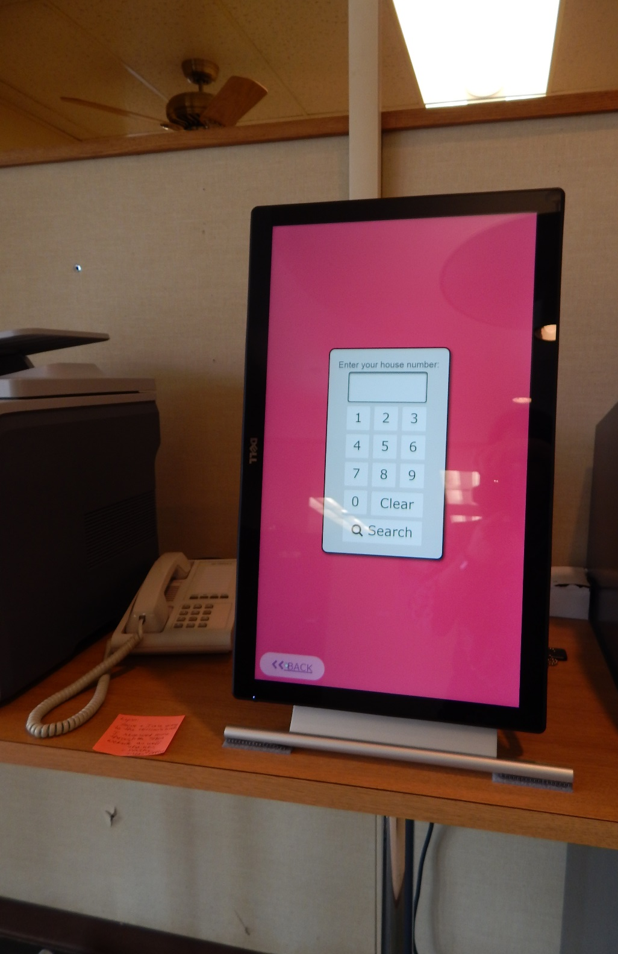

Slide 5
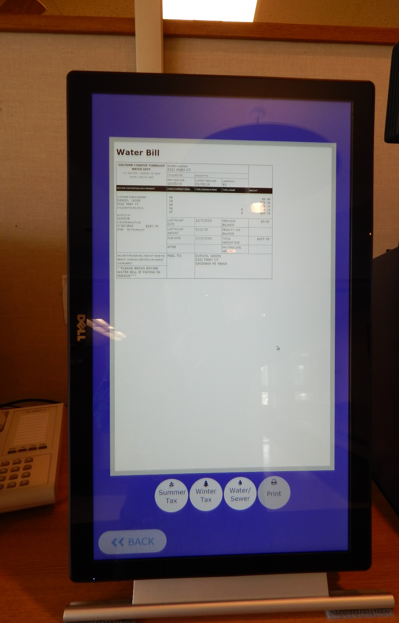

Slide 9
Crime Mapping: Is Any Activity Happening in Your Neighborhood?
Online Crime Mapping
http://www.crimedar.com
Easy access to any business or citizen
Shows property crimes, accidents, arrests, police activity
Gives a brief description of the incident and wanted suspect information
Map Symbols

Slide 10
Officer Worn Body Cameras A Safeguard for our Officers and Citizens
Patrol Car Video Cameras
Audio & Video in all Patrol Cars
Officer Worn Body Cameras
Implementation / Testing Stage
Worn on the front of the uniform shirt.
Video will be stored and saved indefinitely at a very low cost
Excellent technology but not the “crystal ball” of seeing what happened.
DVD video

Slide 11
Saginaw Charter Township’s
Core Values
Provide for a Safe Community.
Promote a Neat, Clean, Attractive Community with Beautiful Neighborhoods.
Provide Quality of Life Amenities.
Maintain a Professional, Well Run, Efficient Government…that Provides High Quality Services to its Residents

Slide 12
